Slide 1
Sales Method Analysis
Pens and Printers

Slide 2
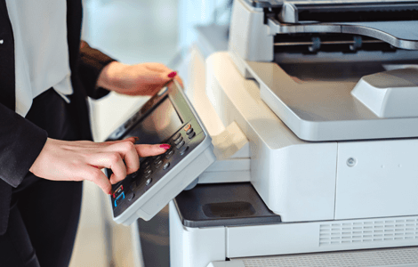
Introduction
New product sales methods on a new line of office stationery
Email
Call
Email + Call
Data from sales tracking system for six weeks

Slide 3
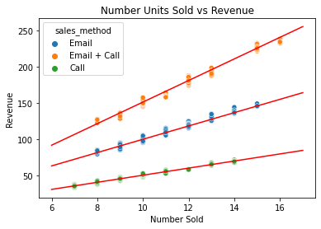
Data Cleaning
Data provided: week, sales method, customer id, number of new products sold, revenue, years as customer, location (state) of the customer/order
Data cleaning is vital to assess the quality of the data provided and to use the most accurate possible data for analysis
The revenue column needed the most cleaning
Able to impute values by sales methods using number of units sold

Slide 4
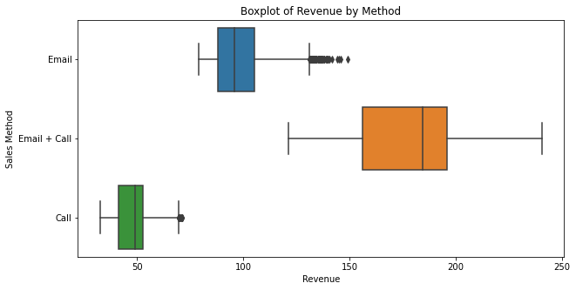
Spread OF Revenue By Sales Method
Number of customers
Email: ~7500
Call: ~5000
Email: ~2500
Three tiers of revenue per customer

Slide 5
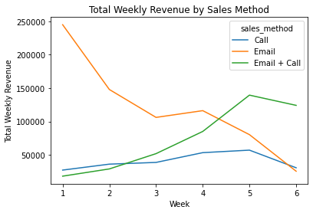
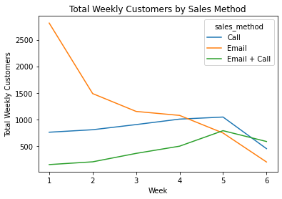
Weekly REVENUE AND CUSTOMERS BY SALES METHOD
Total revenue and customers over the six weeks
Email + Call clearly has the most revenue per customer
Especially noticeable in week six

Slide 6
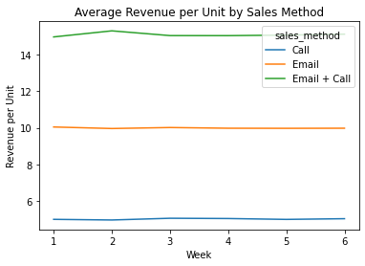
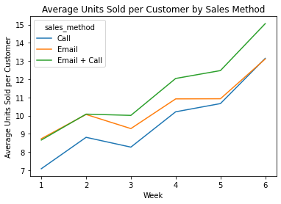
REVENUE PER UNIT AND UNITS PER CUSTOMER BY SALES METHOD
We know it had the most revenue per customer, what about per unit?
Email + Call consistently sells more units and higher-end products (revenue per unit)

Slide 7
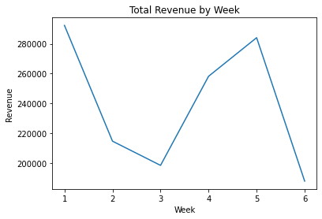
RECOMMENDATIONS
Monitor weekly revenue of a product launch
If revenue decreases for four straight weeks, we recommend assessing if it is still advantageous to continue to carry that product line
Email all customers as it is the least time intensive method, but calling our biggest customers where we have bandwidth available over the upcoming weeks
Collect additional data on products sold and customers contacted without a sale
Is there a reason that email + call was used less often?

